Slide 1
GIT

Slide 2

Agenda
Workflows
GIT
Tools
Learning resources
GIT vs. SVN
GIT concepts (DAG, branch, tag, etc.)
GIT operations (commit, merge, etc.)
Review
Hands-on workshop

Slide 3
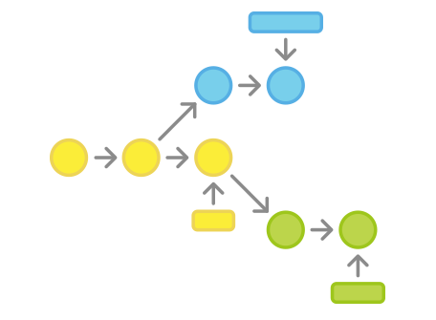
Workflows

Slide 4
Workflows
only one integration branch
one separate release (stable) branch
separate release branches
separate release branches without stable branch
separate hotfix branches
separate feature branches
GIT Flow
diagram
resources

Slide 5
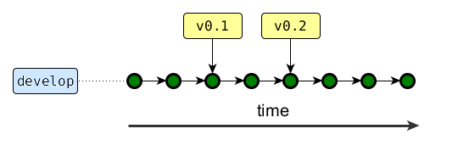
Workflows / only one integration branch
only one branch where everybody works
simple
does not work well when not all team is releasing
Notes:
Conventions
blue rectangles are branches
yellow rectangles are tags
green circles are commits
explain about the release phase
we always tag releases!
about this workflow
simple
does not work if when not all developers are required to stabilize a release, when some need to start work no the next iteration

Slide 6
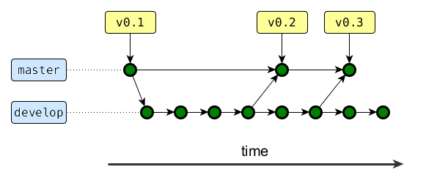
Workflows / one separate release (stable) branch
Notes:
stable branch is called master by in git-flow convention
it always reflects a production-ready state
first step towards continuous deployment
can setup hooks to do release activities (e.g. build a release, run full integration tests suite, etc.) whenever a new commit is done on this branch
hooks can also be setup to automatically deploy to production

Slide 7
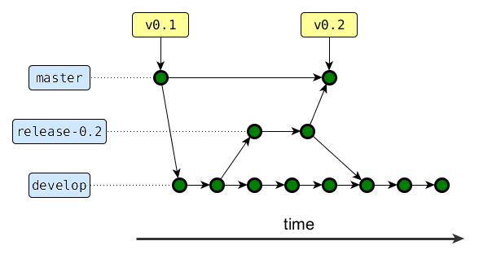
Workflows / separate release branches
Notes:
separate release branches
allow work on the next version while another part of the team stabilizes the release with bug fixes
after the release, the release branch needs to be merged into master (otherwise we lose the bug fixes)
also merge the release branch into the stable branch

Slide 8
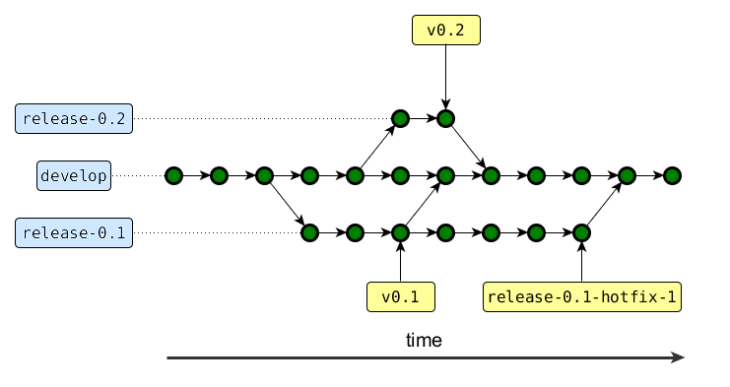
Workflows / separate release branches without stable branch
Notes:
separate release branches simple
like before, but without the stable release branch (master)
the release branch is also used for hotfixes for that release
hotfixes also need to be merged into master, otherwise we lose them
I use this on the current project

Slide 9
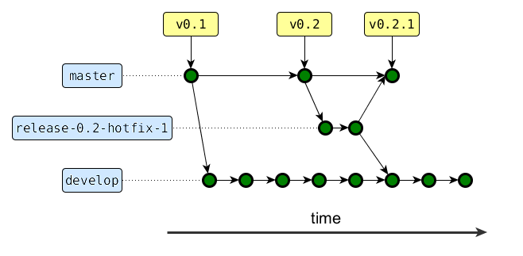
Workflows / separate hotfix branches
Notes:
every hotfix gets its own branch, like any other release
need to be merged back into develop and master upon release

Slide 10
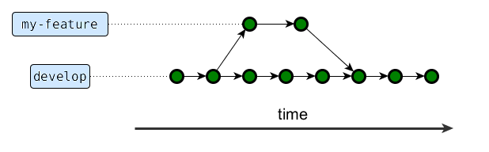
Workflows / separate feature branches
Notes:
every feature gets its own branch
easier to track all changes for a particular feature
easier to completely revert a feature
increased risk of merge conflict: risk increases proportionally with the time until merge to develop
advice: have only one long lived branch (like a big refactoring), otherwise you may face merge hell
risk of merge conflicts can be minimized if the app is really well modularized, and people are not working on features that touch the same files

Slide 11
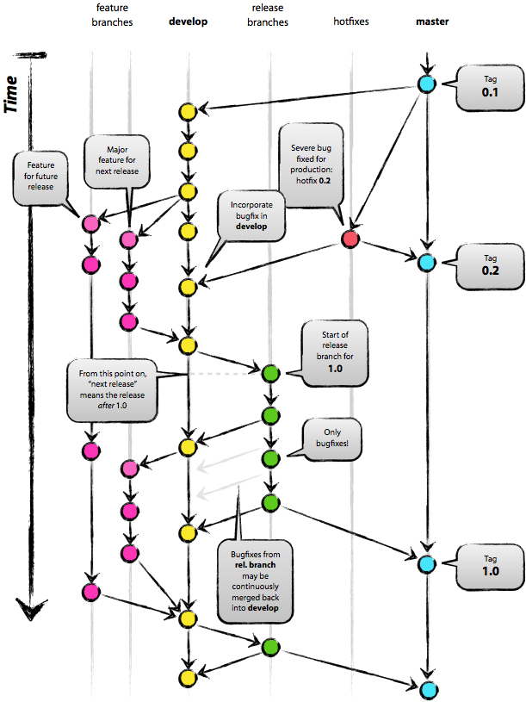
Workflows / GIT Flow / diagram
Notes:
uses all the branch types we discussed
develop (integration) branch
master (stable) branch
release branches
hotfix branches
feature branches

Slide 12
Workflows / GIT Flow / resources
Original GIT Flow article: http://nvie.com/posts/a-successful-git-branching-model/
GIT Flow supporting extension (adds "git flow" command): https://github.com/nvie/gitflow
GIT Flow completion (adds command line bash completion for the GIT flow supporting extension): https://github.com/bobthecow/git-flow-completion

Slide 13


Slide 14
GIT / Tools
command line – required by other tools (http://git-scm.com/downloads)
Windows-only: TortoiseGit (https://code.google.com/p/tortoisegit/wiki/Download)
SourceTree (http://www.sourcetreeapp.com/)
IntelliJ (http://www.jetbrains.com/idea/download/)
etc.

Slide 15
GIT / Learning resources
GitHub training videos: http://youtu.be/FyfwLX4HAxM
Youtube tutorials: https://www.youtube.com/results?search_query=git+tutorial
git help [command]
ProGit Book (free): http://git-scm.com/book
A Visual Git Reference: http://marklodato.github.io/visual-git-guide/index-en.html
git ready (tips): http://gitready.com/
Git Internals (really useful to remove the "magic"): https://github.com/pluralsight/git-internals-pdf

Slide 16

GIT vs. SVN

Slide 17
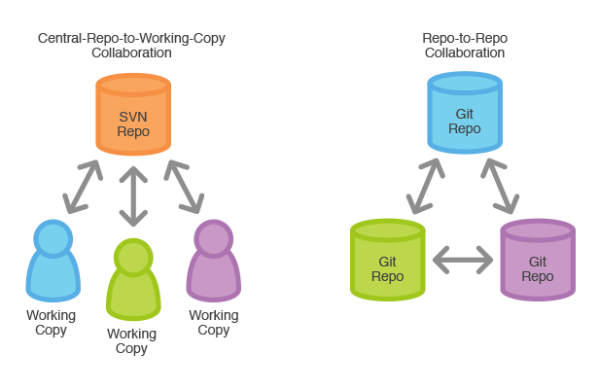
GIT vs. SVN / Distribution / Repositories
GIT is distributed, SVN is not ➔ more flexibility
Notes:
each developer has the entire history
faster than SVN because most operations as local (e.g. log)
side benefit: the repository is backed-up on many more locations (on developer’s computer)
HDD space not a problem
GIT is very efficient
HDDs are cheap
GIT also allows us to have a central repository, it just doesn’t force it
for our projects we will use a central repo for CI
but GIT allows developers to communicate between themselves if needed (e.g. work together on one feature)
no need of a server. This can be quite useful. For example, I use it locally to version some documents.
having all history locally enables 2 features which would be too slow on SVN:
git pickaxe
git bisect

Slide 18
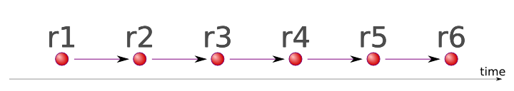

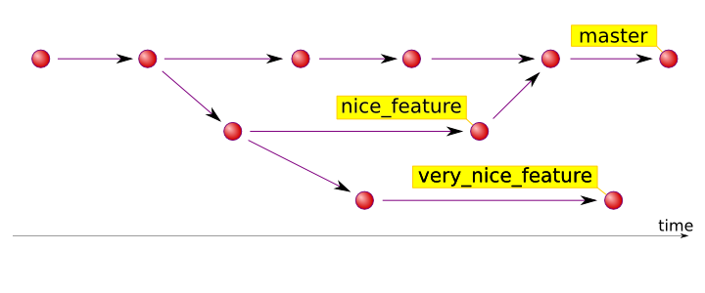
GIT vs. SVN / History
GIT has real branches (DAG), SVN has linear history with simulated branches (just directories)
SHA1 (295f3c241859d6fab606a7cb1a7598d2af7a1a3e)
Notes:
IDs
in SVN, you identify a commit using the revision number
because GIT is distributed, you don’t know the sequence of commits on 2 different branches. GIT uses a cryptographical hash function, SHA1. It’s like MD5, but much stronger. GIT uses this as a commit identifier.

Slide 19
GIT vs. SVN / More on Branches
in SVN you checkout different branches into different directories
in GIT you switch between branches in the same directory

Slide 20
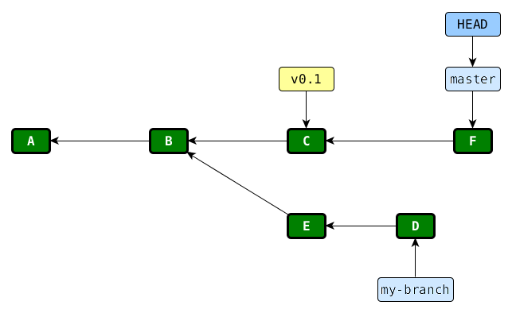
GIT concepts / DAG
Notes:
DAG (directed acyclic graph) of commits
each commit has a SHA1 identifier in GIT, but I represented them by letters to make things easier to understand
each commit points to its parent
master and my-branch are branches
a branch is a label pointing to a particular node in the graph
because of the parent-child link between commits, we say that “commit E is on branch my-branch” because it’s reachable from my-branch. Commits A and B are on both branches (my-branch and master)
the special label “HEAD” points to the current branch (that’s how GIT know what is the current branch)
v0.1 is a tag. A tag is like a branch in that it points to a commit, but a tag does not change. It will always point to the same commit.
We will use this kind of diagrams to explain GIT commands

Slide 21
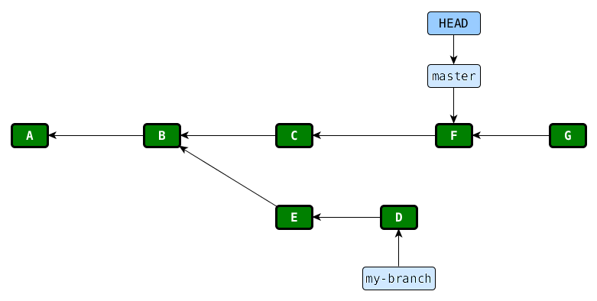
GIT commit / 1 of 2
Notes:
first a commit is added with its parent pointing to the current commit (which is HEAD)

Slide 22
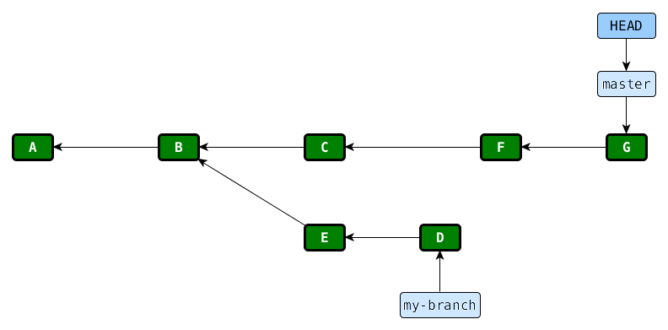
GIT commit / 2 of 2
Notes:
after that the master branch is modified to point to the new commit
notice that HEAD did not change – it still points to the master branch, because we didn’t changed branches

Slide 23
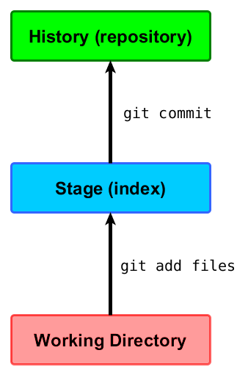
GIT commit / staging area
Notes:
difference with SVN:
git add does not mark the file to be added: it takes a snapshot of the state of the file
if you modify the file after running add, you need to call add again
you can delete the file in your file manager and the call add to "add the deletion" – to tell git you intended to delete that file
I don't like this feature, but others like it
fortunately, you only have to know about this when committing from the command line, since TortoiseGit and IntelliJ hide this intermediate step

Slide 24
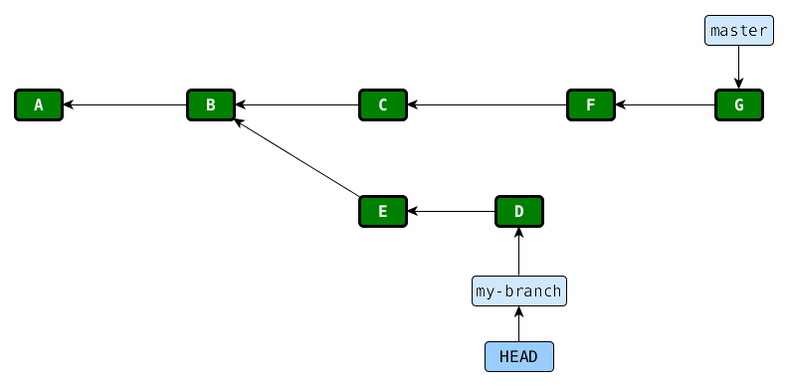
GIT checkout my-branch
Notes:
2 things happens
the HEAD label changes to point to the new branch (my-branch)
the files in the working directory are changed to reflect the state of the files in my-branch

Slide 25
GIT unifying divergent histories
two ways:
merge
rebase
Notes:
working on different branches is cool, but to benefit from that work, you need to unify branches

Slide 26
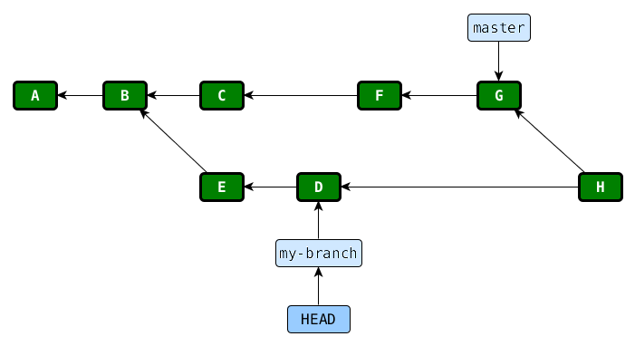
GIT merge master into my-branch /1 of 2
Notes:
first a new commit is created (H) that contains all the changes that were previously only in master (the changes introduced by C, F, and G)
notice that this commit has 2 parents – this is how GIT knows that H is a merge commit
if there are no conflicts, GIT commits automatically, otherwise you need to solve conflicts and the commit yourself

Slide 27
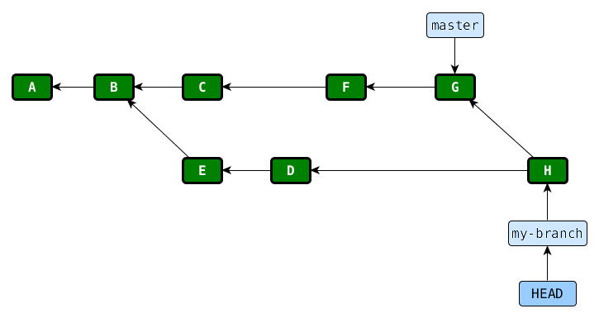
GIT merge master into my-branch /2 of 2
Notes:
after the commit is created, my-branch is changed to point to the new commit
Observations:
- the commit H contains all the changes in commits C, F, and G, so if you try to understand the history without comparing with the master branch, you can be lost
- GIT can merge multiple branches at one time (not only 2), but I don’t recommend it since it can get quite difficult to solve conflicts or understand the history later
- just because you did not have a conflict it doesn’t mean the merge was successful. Imagine the following scenario: someone on branch A deletes a configuration property, while another developer on branch B creates a class that uses that property. Merging both A and B into master will be successful (no line conflicts), but the result is broken. So, always run the tests after merge. Also, this is one more reason not to merge multiple branches at one time (merge 2 branches multiple times: A into master, then B into master)

Slide 28
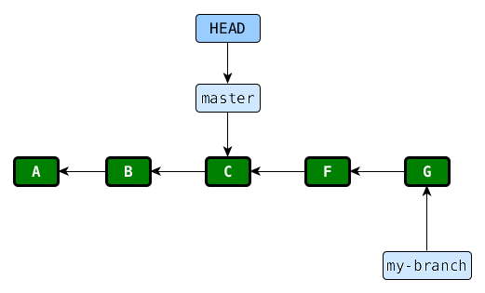
GIT fast-forward merges

Slide 29
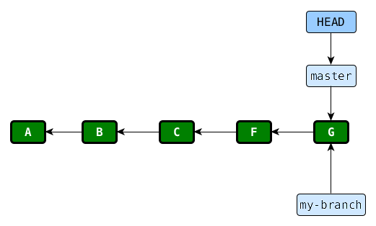
GIT fast-forward merge my-branch into master
Notes:
special kind of merge, if the branches have not diverged
no new commit is created, only the branch label is changed to point to a different commit

Slide 30
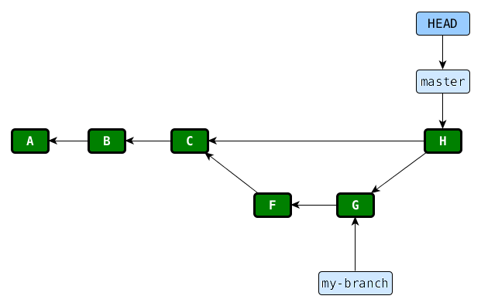
GIT merge my-branch into master forcing non-fast-forward (--no-ff)
Notes:
the problem with a fast-forward merge is after you do it, you can no longer tell from the history that F and G were developed on a separate branch. If you care about this, you can force GIT to create a commit using a command line argument (“--no-ff”)

Slide 31
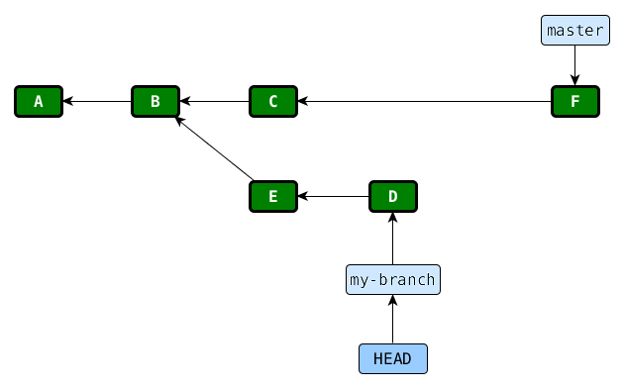
GIT rebase my-branch on top of master / 1 of 6
Notes:
rebase will create linear history: A, B, C, F, E, D.
one example where you would need this is when using GIT as an SVN client, since SVN only knows of linear history
because the history is linear, people will not know that E and D were developed on a separate branch, which is something that you may or may not want

Slide 32
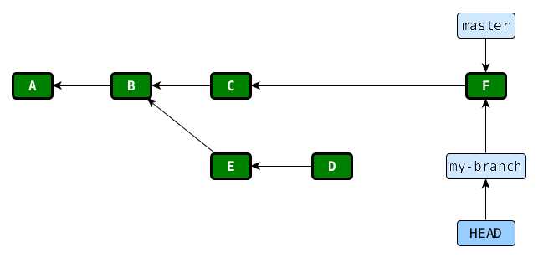
GIT rebase my-branch on top of master / 2 of 6
Notes:
the my-branch will first point to the same commit as master

Slide 33
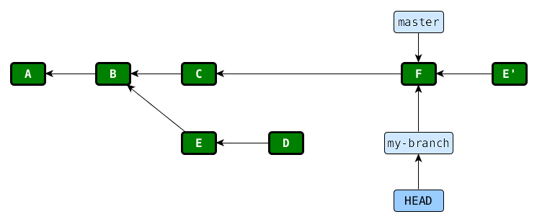
GIT rebase my-branch on top of master / 3 of 6
Notes:
a commit E' is created that introduces the same changes as E
the new commit is not exactly the same, since it has a different parent, a different commit time, etc. In other words, E and E' have different SHA1 IDs.
the new commit may conflict with changes made in commit C or F. These conflicts will need to be manually solved and then rebase can continue

Slide 34
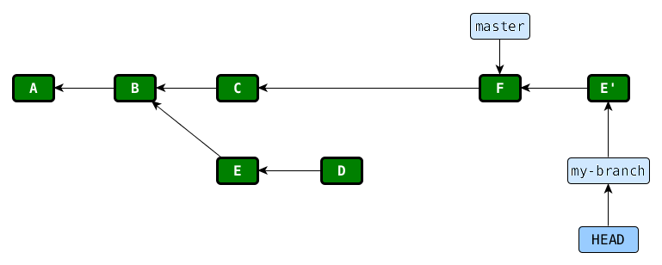
GIT rebase my-branch on top of master / 4 of 6
Notes:
because it’s the current branch (as shown by HEAD), my-branch will then point to the new commit

Slide 35
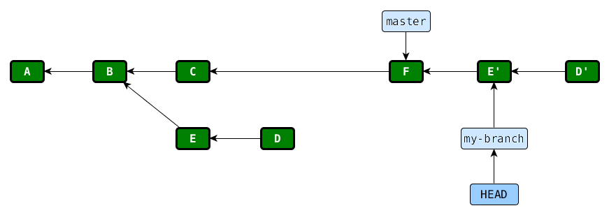
GIT rebase my-branch on top of master / 5 of 6
Notes:
the commit D' is created that introduces the same changes as D

Slide 36
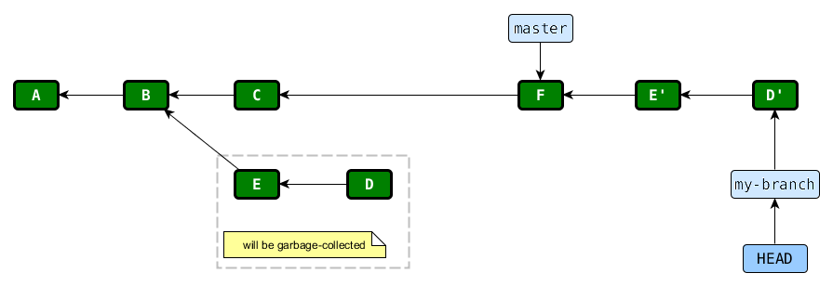
GIT rebase my-branch on top of master / 6 of 6
Notes:
lastly, my-branch changes to point to the new commit
at this point we are done with the rebase and the history is linear
the commits E and D are no longer reachable by any branch or tag, so they will be garbage collected in time. GIT performs garbage collection automatically from time to time, and you can also manually force it using the “git gc” command
What if you made a mistake? For example you manually solved conflicts incorrectly, and you want to re-try the rebase. Since the commits E and D are not yet deleted, we can. We’ll take a look at an example during the workshop when we discuss about the “git reflog” command.
don’t rebase public history

Slide 37
GIT commit --amend
"git commit --amend" creates a new commit that contains changes from both the last commit and changes in the working directory

Slide 38
GIT rebase --interactive
"git rebase --interactive" creates an alternate history and allows you to:
reorder commits
drop some commits (like they were never done)
insert commits in between other commits
squash multiple commits into one
split one commit into multiple commits
some of these operations (like reordering) may result in conflicts that need to be manually resolved

Slide 39
GIT filter-branch
"git filter-branch" allows you to create an alternate history using scripts (e.g. run "sed" for all commit messages)

Slide 40
GIT / re-writing history
these commands allows to re-write history
rebase
rebase --interactive
commit --amend
filter-branch
never! (ever, ever, ok sometimes , ☺) re-write public history (commits that have been pushed to a public repository

Slide 41
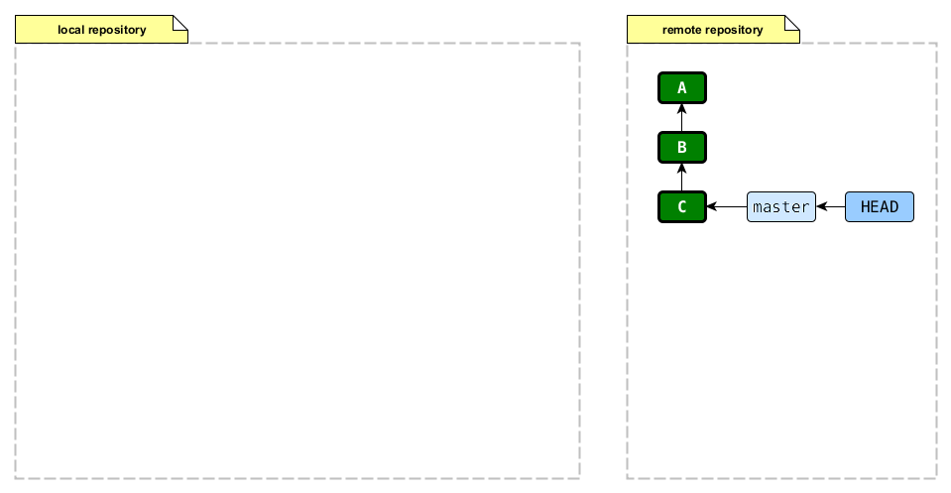
GIT clone / 1 of 4
use "git clone" to "copy" a remote repository, to start work

Slide 42
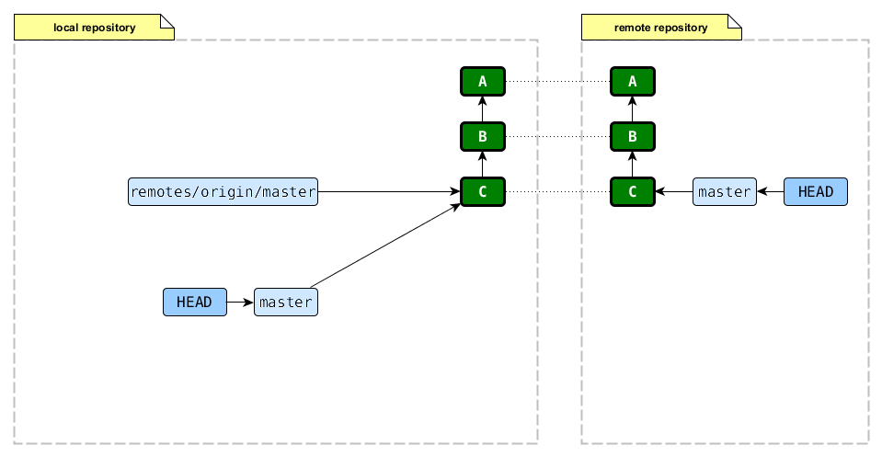
GIT clone / 2 of 4
Notes:
the commits A, B, and C in the local repository are identical to A, B, and C in the remote repository – the have the same SHA1 ID
2 branches are created:
remotes/origin/master
this is what you local repository thinks that the remote branch looks like.
never commit on this branch
this branch will only be updated when you pull changes from the remote repository
master
this is where you will do your commits
notice this is the current branch after clone

Slide 43
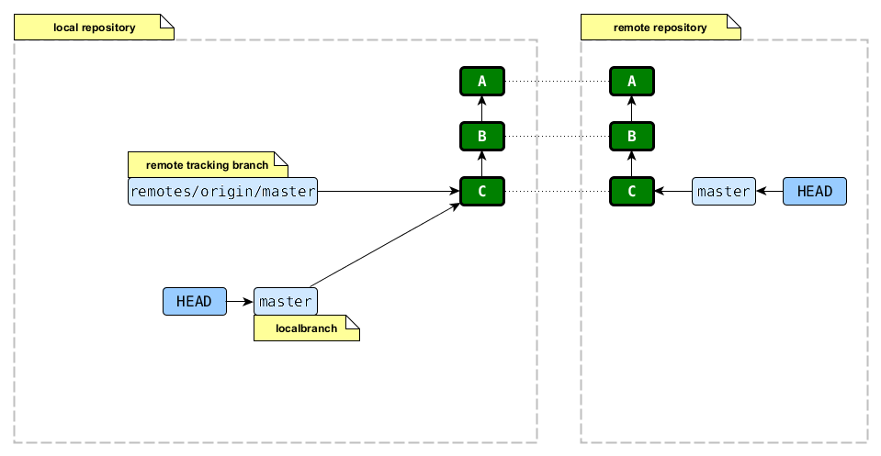
GIT clone / 3 of 4
Notes:
master is called a “local branch“
the branch "remotes/origin/master“ is called a "remote tracking branch" because it’s purpose is to track the remote branch – to be a one-to-one copy of the remote branch
all remote tracking branches are by default under "remotes/"
"origin" is a name that you give to the remote repository (GIT uses it’s URL instead) and is called a "remote". You can have multiple remotes since GIT doesn’t restrict you to communicate with only one remote repository.
"origin" is the name that GIT chooses when cloning a remote repository, but there is nothing special about it

Slide 44
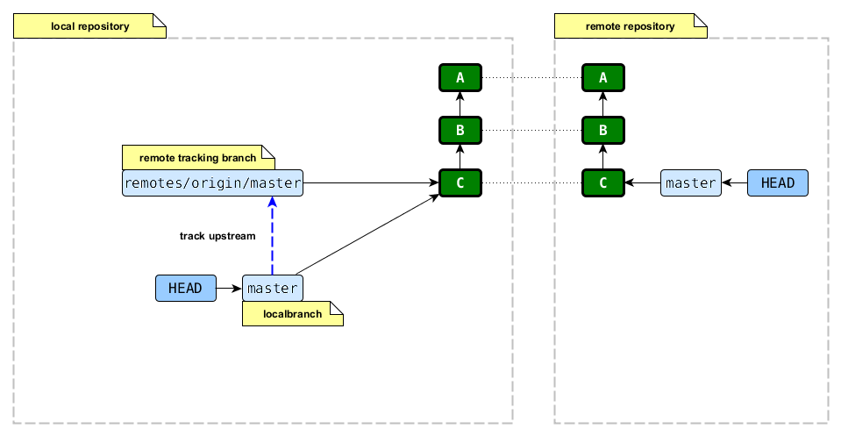
GIT clone / 4 of 4
Notes:
master is said to "track the upstream branch remotes/origin/master"
this link is needed for example for GIT to know to which remote repository to push changes when the current branch is master and you don't specify a remote name when pushing
other commands that use this
merge, when you don't specify what branch to merge into the current branch
rebase, when you don't specify what on top of which branch to rebase the current branch

Slide 45
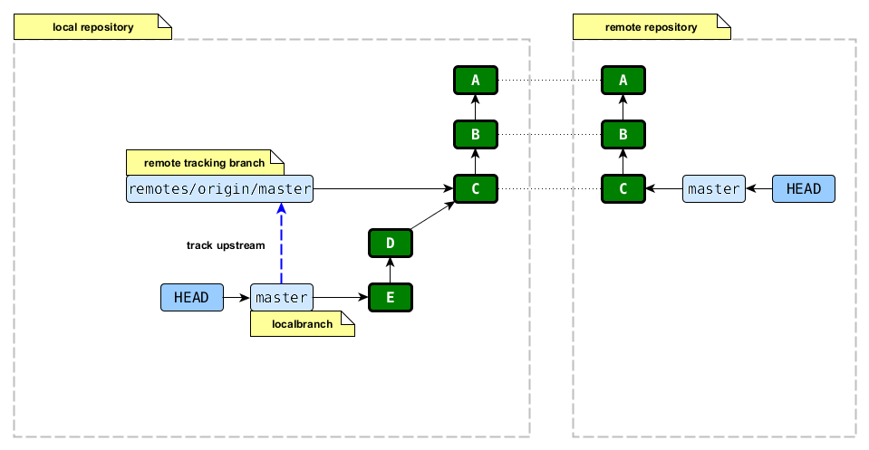
GIT push / success case / 1 of 5
all commit/merge/rebase operations are local
"git push" sends the commits to another GIT repo
Notes:
we create locally 2 more commits: D and E and we push them

Slide 46
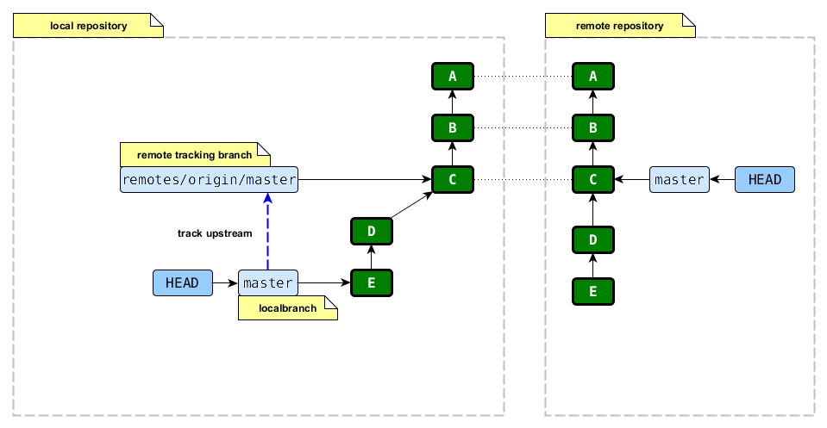
GIT push / success case / 2 of 5
Notes:
first the commits D and E are created in the remote repository. These commits are identical to D and E in the local repository – they have the same SHA1 ID

Slide 47
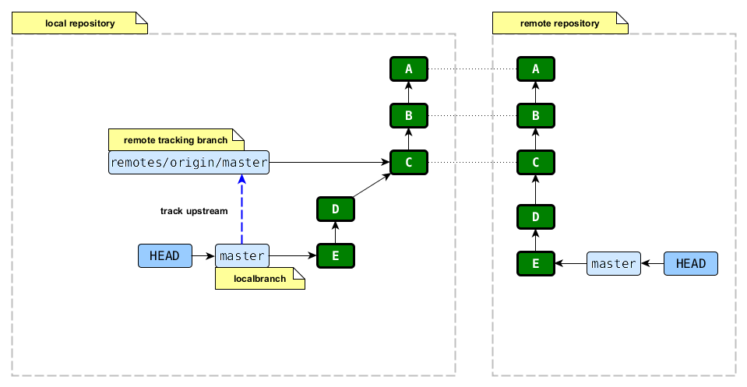
GIT push / success case / 3 of 5
Notes:
then the master branch on the remote repository is set to point to E (the new tip of the branch)

Slide 48

GIT push / success case / 4 of 5
Notes:
in the local repo, the branch "remotes/origin/master" is set to point to D, since that is where the "master" branch points to in the remote repository
and we are done

Slide 49
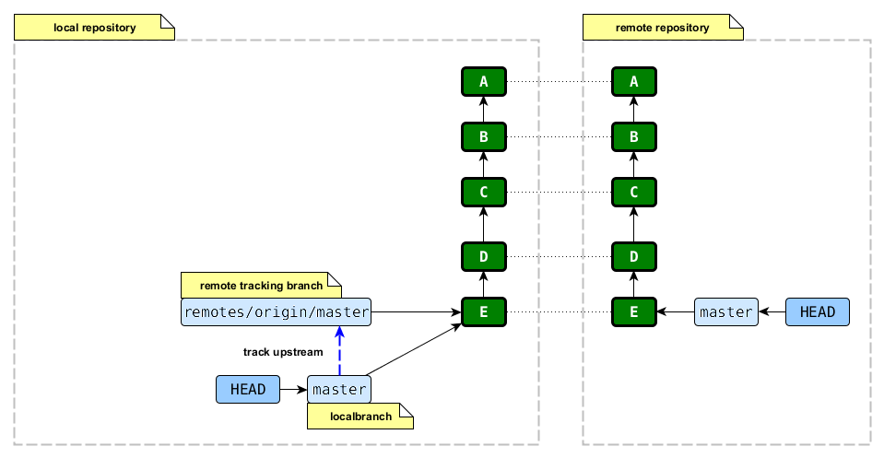
GIT push / success case / 5 of 5
Notes:
(this diagram only changes the layout)

Slide 50
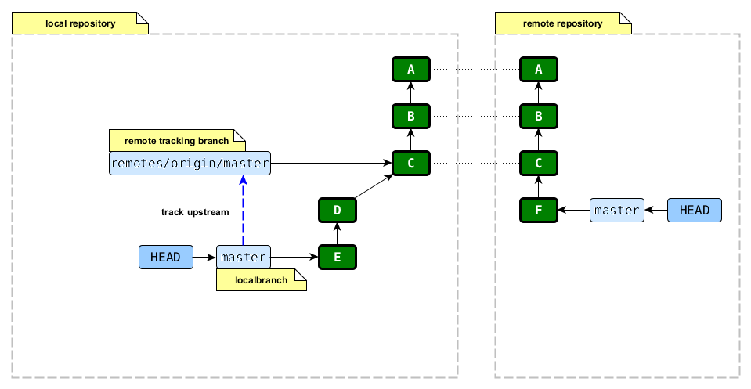
GIT push / error case / 1 of 4
Notes:
we create locally 2 more commits: D and E and we push them
in the mean time, someone else pushed commit F to the remote repo
because of this, we won't be able to push until our master branch also contains the F commit (GIT will give an error when trying to push)
we can incorporate the commit F using merge or rebase

Slide 51
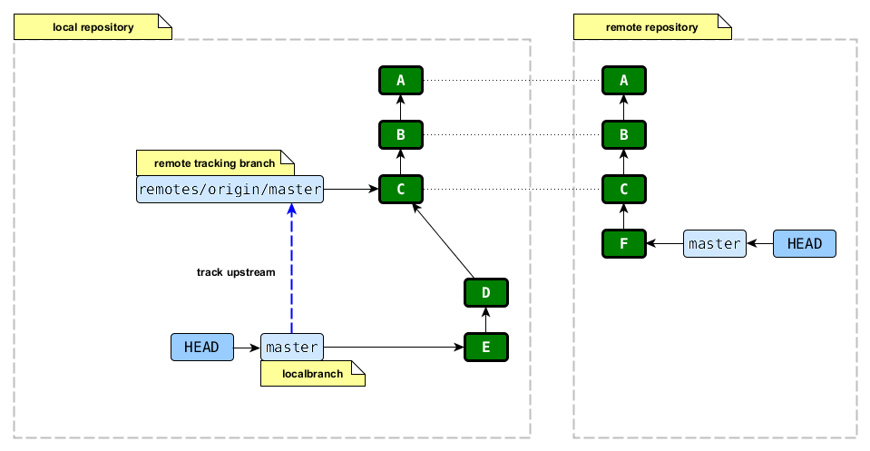
GIT push / error case / 2 of 4
Notes:
(same as previous slide, only a small re-arrangement)

Slide 52
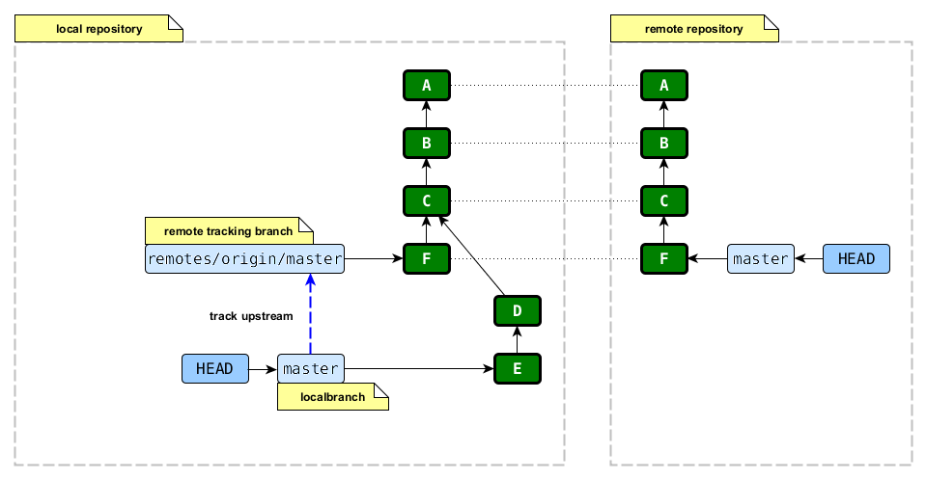
GIT push / error case / 3 of 4 / fetch
Notes:
but merge or rebase are local operations
to be able to merge or rebase, we first need to have the commit F in the local repository
to get it we use the "fetch" GIT command
now we can see that the history diverged in the 2 branches

Slide 53
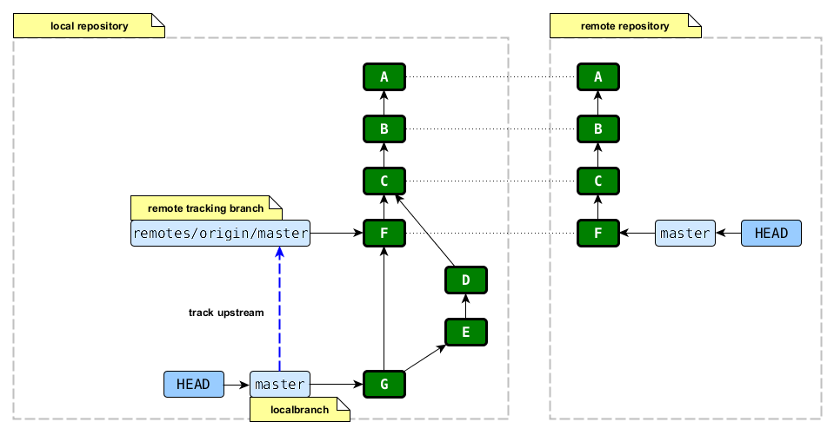
GIT push / error case / 4 of 4 /
merge 1 of 4
Notes:
we merge the remote tracking branch (remotes/origin/master) into the local branch (master) and this results in a new commit: G
since our new local branch master contains all the changes in the remote repository, GIT will now allow us to push

Slide 54
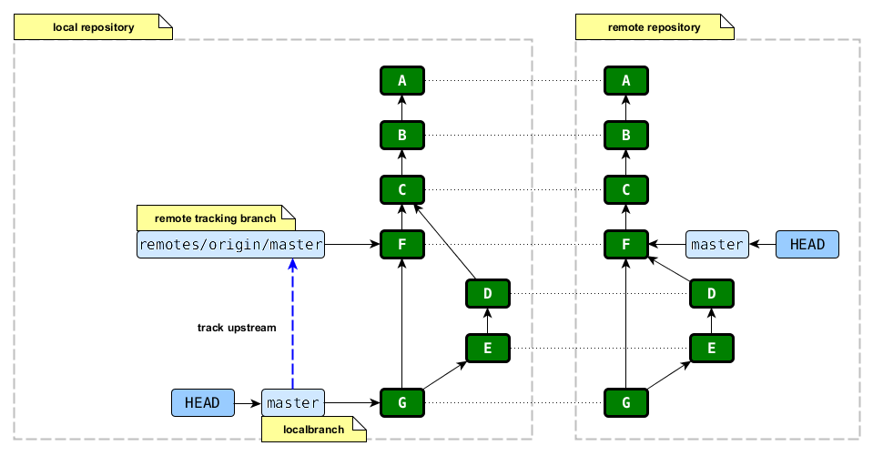
GIT push / error case / 4 of 4 /
merge 2 of 4

Slide 55
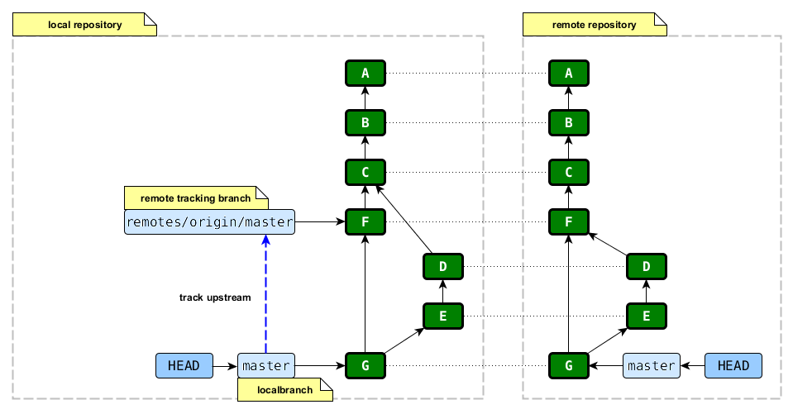
GIT push / error case / 4 of 4 /
merge 3 of 4
Notes:
we create locally 2 more commits: D and E and we push them

Slide 56

GIT push / error case / 4 of 4 /
merge 4 of 4
Notes:
we create locally 2 more commits: D and E and we push them

Slide 57
GIT push / error case / 2 of 4
Notes:
let's resolve the conflict by using rebase instead of merge

Slide 58
GIT push / error case / 3 of 4 / fetch
Notes:
we start by fetching the changes from the remote repository, just like in the case of merge (they are both local operations)
if you use GIT as an SVN client, this is the only option because rebase, unlike merge, keeps the history linear (SVN can't handle non-linear history)

Slide 59
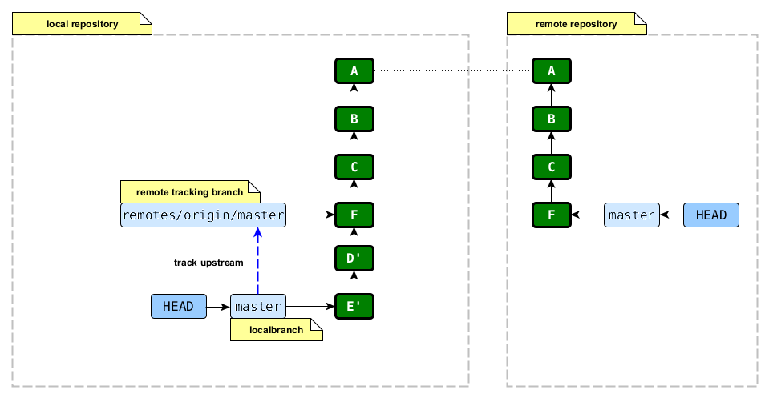
GIT push / error case / 4 of 4 /
rebase 1 of 4
Notes:
this is how the local repository looks after rebase
since our new local branch master contains all the changes in the remote repository, GIT will now allow us to push

Slide 60
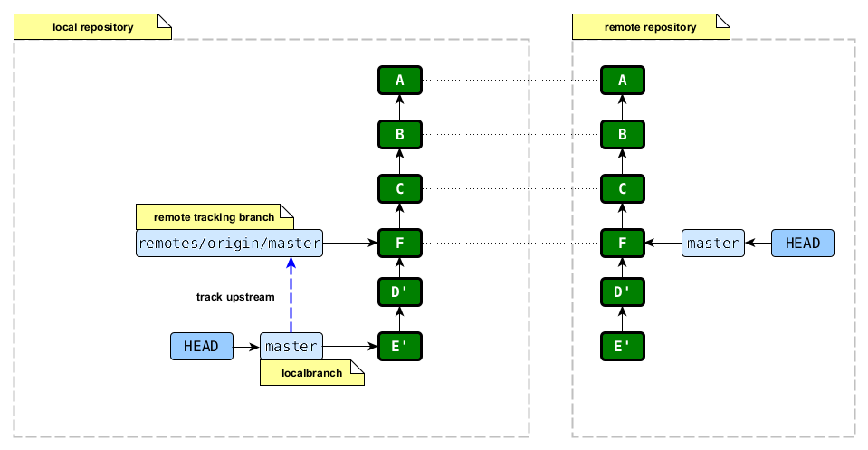
GIT push / error case / 4 of 4 /
rebase 2 of 4

Slide 61
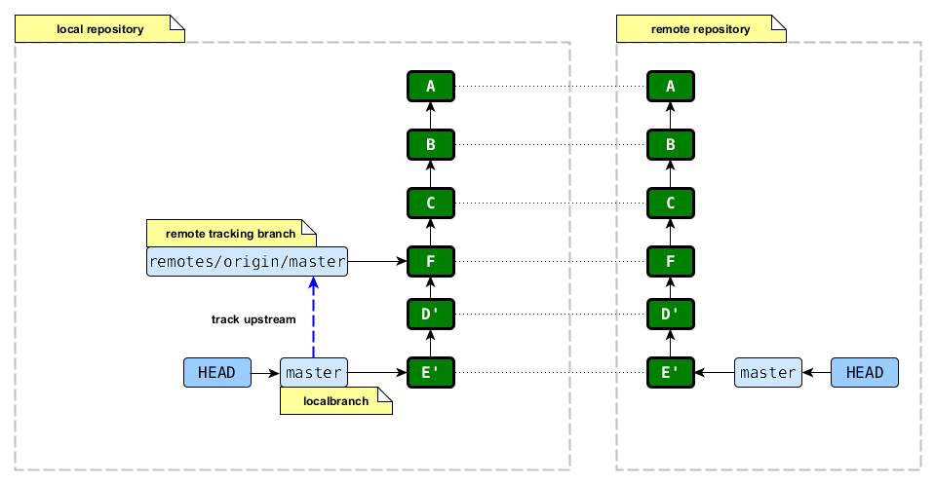
GIT push / error case / 4 of 4 /
rebase 3 of 4

Slide 62

GIT push / error case / 4 of 4 /
rebase 4 of 4

Slide 63
GIT pull vs. fetch
"git fetch" brings commits from the remote repository into the local repository
"git pull" == "git fetch" + "git merge"
"git pull --rebase" == "git fetch" + "git rebase"
Notes:
if your workflow is to commit everything to master (trunk in SVN), then you may want to use the "rebase" version of pull, otherwise the commit history will be polluted with merge commits that makes things harder to understand
I personally prefer to use fetch and then merge/rebase rather than pull, because that gives me a chance to take a look at the remote commits before merging/rebasing

Slide 64
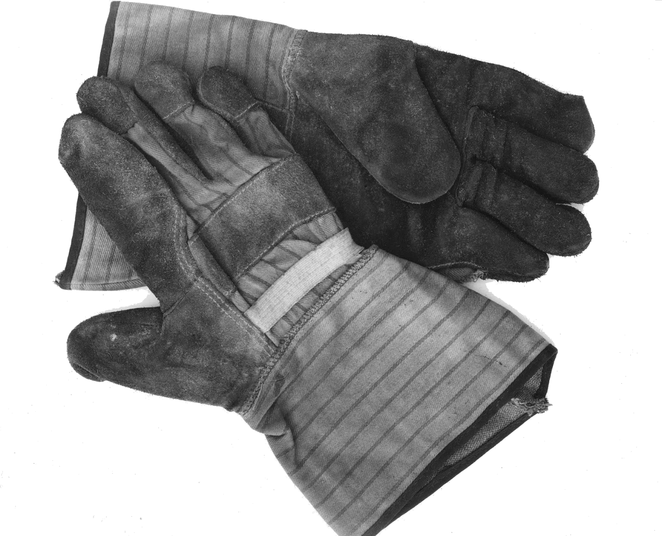
Hands-on Workshow
Time to get the hands dirty
Notes:
install GIT
Windows
Mac
setup username and email

Slide 65
Hands-on Workshow
install GIT
setup username and email
git config --global user.name "John Doe"
git config --global user.email johndoe@example.com
look at the config file
install TortoiseGIT
checkout the slides from https://github.com/cvmocanu/git-presentation.git
Notes:
config (these override each other)
system: /etc/gitconfig (inside Program Files on Windows) → for all users
global: ~/.gitconfig → per user
local: .git/config (in the repository) → per repository

Slide 66
Hands-on Workshow
commands
git help [command] (plus Google)
git init
git ignore
git add
git rm
git mv
git "guesses" renames based on content similarity
therefore: do rename and refactoring in separate commits
git commit [--amend]
git merge [--no-ff] [--ff-only]
git rebase
git rebase --interactive
git reflog
git fetch
git pull [--rebase]
git push
git branch
git tag

